Slide 1
Python Hackathon
Data analysis of Supermarket Dataset
-By Nikesh Maurya

Slide 2
Problem Statement
Problem Statement: AJ Ecom Pvt Ltd is one of the leading business who have supermarkets across different regions of India. They want to understand the performance of their supermarket in terms of customers, products and its sale.
Dataset given are:
Customer.csv
Customer_id: Unique id for the customer
DOB: Date of birth of customer
Gender: Male or female sex of customer
City code: Unique code of city of customer

Slide 3
Continue…
Dataset File 2: Prod_cat_info.csv
Prod_cat_id: id of product of a particular (main) category
Prod_cat: Unique type (Category of product) Prod_sub_cat_code: Sub-category code of the product
Prod_sub_cat: Sub category description
Dataset File 3: Transaction.csv
Transact_id: Unique id of transaction done by customer
Cust_id: customer id
Transact_date: Date on which customer has made the transaction
Prod_subcat_code: sub category of the product Prodcat_code: main category of the product
Qty: Quantity of item purchased (ignore the negative symbol)
Rate: Price to be paid ( Ignore the negative symbol)
Tax: GST as per rate Total_amount: Amount paid by customer Store_type: Different types of stores present in the mark

Slide 4

Dashboard

Slide 5
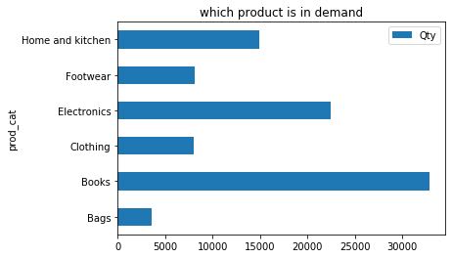
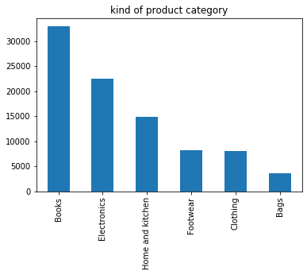
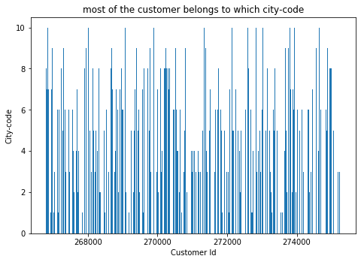
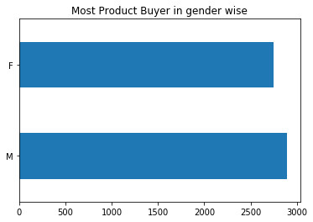

Slide 6
Insight
1. who buys product more male or Female
2. most of the customer belongs to which city-code
3. which customer has bought maximum product
4.what is minimum and maximum sale
5. what kind of product category we have in supermarket
6. which store type has maximum engagement
7. which product is in demand
8. which product gave maximum sale

